Slide 1


Project STAR
Analysis on how student test scores are affected by environmental factors
Anshika Ahuja
Truett Bloxsom
Dandi Chen
Jake Hill
Yue Tian
Notes:
Dandi

Slide 2

Agenda
Project Description
Data Transformation
Models
Result & Inference
Conclusion
Notes:
Dandi

Slide 3
Project Background
The Student/Teacher Achievement Ratio (STAR) was a four-year longitudinal class-size study conducted in Tennessee.
Over 7,000 K-3 students in 79 schools were randomly assigned into different class size and teachers
Our goal: Test score prediction
Datasource: Harvard Dataverse
Notes:
Dandi
See if smaller class would improve student test scores

Slide 4
Dataset and Transformation
The data consists of 5,726 rows of data and 11 variables
Remove missing values
Set dummy variables for categorical variable
Small class vs Non-small class
Scaled Teacher’s experience
Personal
Sex
Race
Reading, Math score
Total score
Environmental
Classroom size
Teacher Education
Teacher Experience
Teacher Race
School Type
Social-economic status
Notes:
Dandi

Slide 5
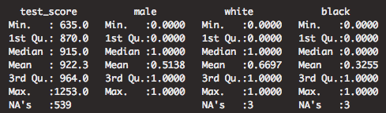
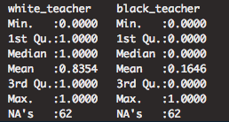
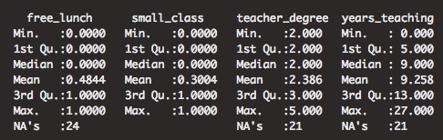
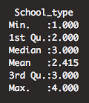
Data Summary
Notes:
Anshika -> Test scores of students mean of --, male dummy variable for students sex 51% males, white(66.97%) black race(32.55%) of students, white(83.54%) black race(16.46%) of teachers, free lunch=1 ->low economic status
School types 1 inner city, 2 suburban, 3 urban, 4 rural

Slide 6
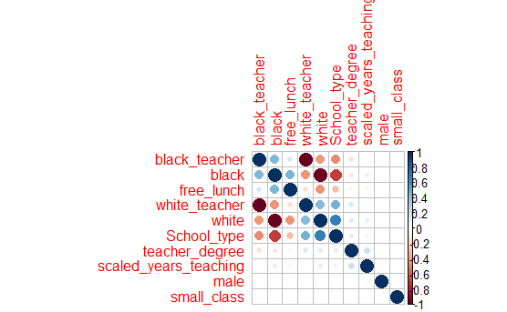
Correlation plot
Notes:
Anshika - correlation plot to check correlation between diff variables, +ve blue, -ve red
Opposite of correlation = polarity (https://www.merriam-webster.com/thesaurus/correlation)

Slide 7
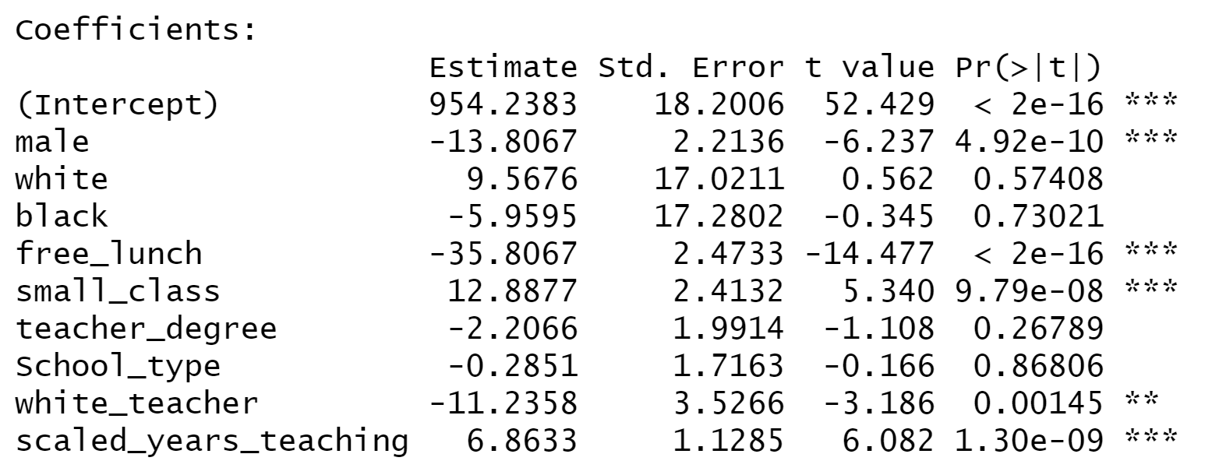
Multi Linear Regression/Best Subset
MLR: free_lunch, male student, years_teaching, small_class are most significant variables
RMSE: 69.97
Notes:
Anshika
Using interaction terms improved standard error by 0.25… so not much. Toss it out!

Slide 8
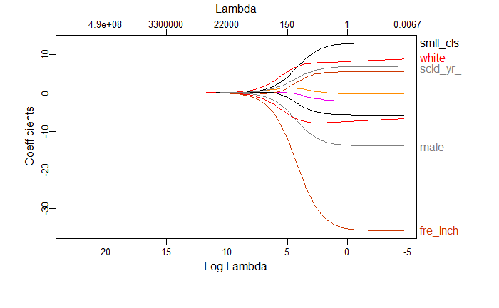
Ridge
Best λ = 2.7
MSE = 4891.421
Notes:
Yue Conclusion for each model at the end
From the graph we can see that as λ increases, the ridge coefficient estimates decrease leading to decreased variance but increased bias.
We use cross-validation to choose the best λ and the value of λ that results in the smallest cross validation error is 2.7.
The test error we got using the best λ is 4891.421.

Slide 9
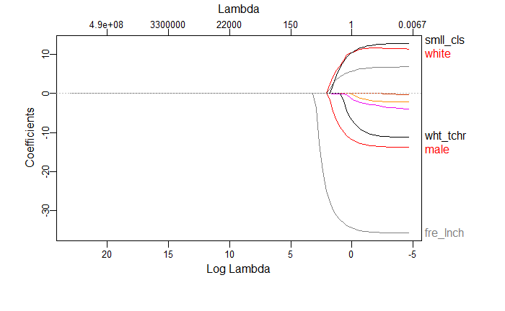
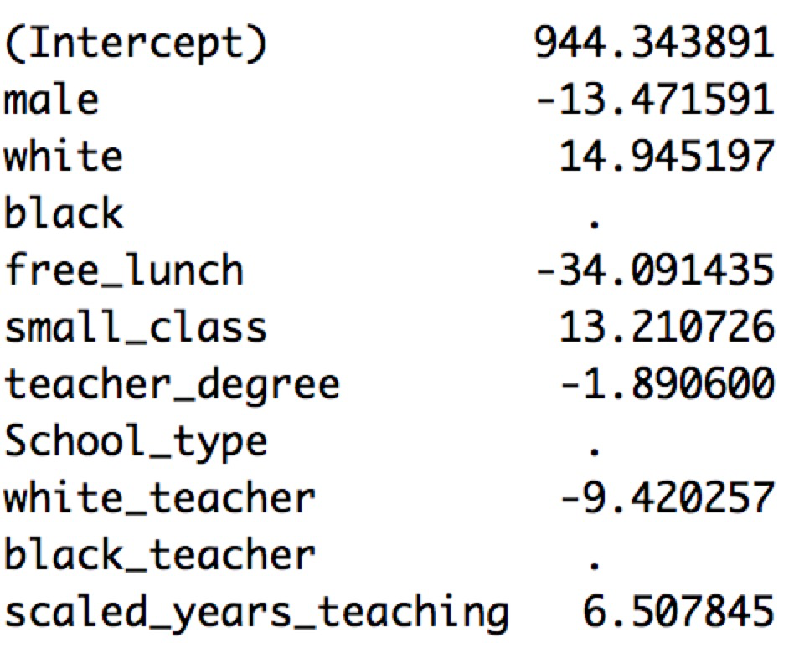
LASSO
Best λ = 0.21
MSE = 4890.232
Notes:
Yue
Conclusion for each model at the end
However, ridge regression will always generate a model involving all the predictors. So we also fit a lasso models that involve only a subset of the variables. The procedure is similar to fitting in the ridge model. We used cross-validation to choose the best λ and the value we obtained was 0.21. The test error for the lasso model using this λ is 4890.232, and we see that 3 coefficient estimates are exactly zero. So the lasso model contains only seven variables: male, white, free_lunch, small_class, teacher_degree, white_teacher, and scaled_years_teaching.
Since lasso involves less variables and decreases the test error, it is easier to interpret and relatively more accurate.

Slide 10
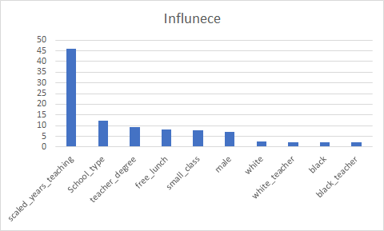
Boosting
Notes:
Jake

Slide 11
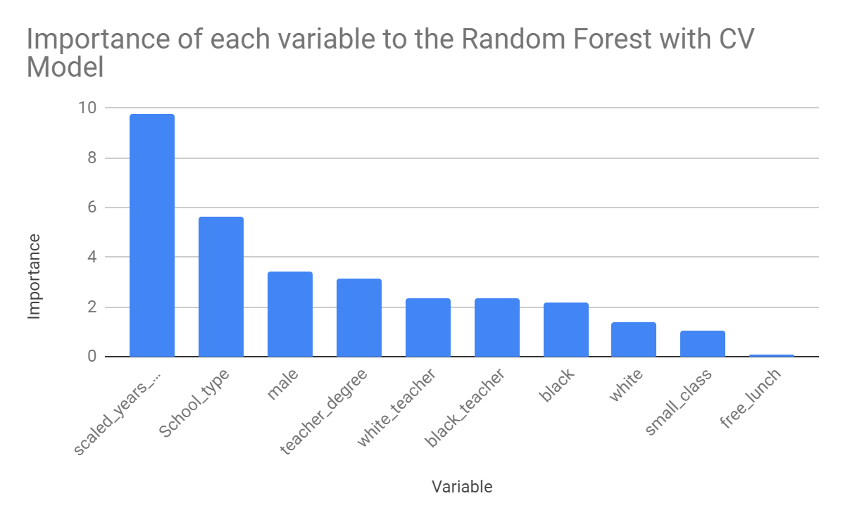
Random Forest
Notes:
Jake
This slide needs to be changed!
Size of best.tree is 173

Slide 12
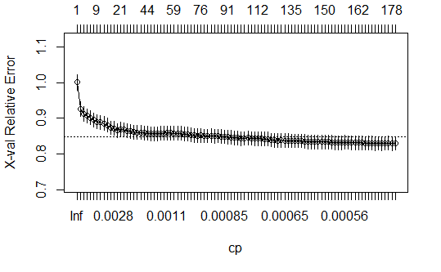
Random Forest
size of big tree: 179
size of best tree: 173
bestcp: 0.0005162045
Notes:
Jake
This slide needs to be changed!
Size of best.tree is 173

Slide 13
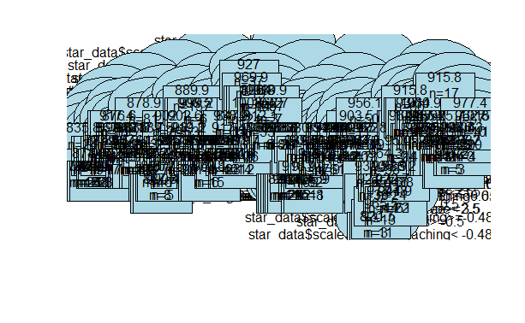
Random Forest
Great for prediction, not so great for presentation...
Notes:
Jake

Slide 14
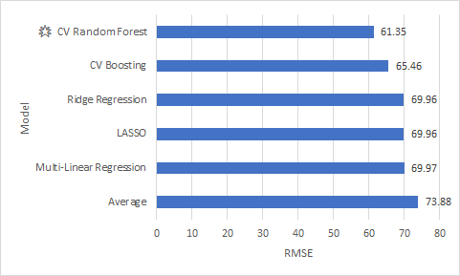
Model Performance
Notes:
Truett: Lets look at all of our models performance based on RMSE. Predicting the mean for all of our test scores , we obtain an RMSE of 73.88. This will be our baseline. This can be interpreted as our predicted test score and actual test score can be off by 73.88 points.
Using all of our variables in a MLR model, we reduced the RMSE to 69.97. Using LASSO or Ridge did not really improve over MLR because neither took out or reduced the significance of may variables.
Once we get to CV Boosting, our RMSE reduces considerably, and CV random forest was our best model with an RMSE of 61.35. This is an improvement of 17% accuracy over the average. 1:10

Slide 15
Inferences
Kindergarteners are hard to predict
Omitted variable bias
Cannot solely trust MLR
Years teaching and school type
There is less significance between Class type and test scores compared to other variables
Notes:
Truett
Ok, lets just start with the facts: its hard to predict what kindergarteners are going to do. Especially when it comes to test scores. We found that many of our variables were significant predictors of test scores when we looked at MLR, LASSO, and Ridge. But we were only able to increase the prediction accuracy by 17% form the baseline.
Our biggest problem was omitted variable bias. Since test scores can basically be thought of as IQ test, there are so many factors that influence IQ and our data set did not provide many of them.
Comparing MLR to boosting, we can see how much the significance of the variables changed: in MLR, school type was less significant or taken out by LASSO, and our boosting model showed that it was the second most important variable in predicting test scores.
Overall our findings show that the STAR program which was suppose to determine if students in small classes improved test scores, that the significance of class size is reduced compared teacher’s years of experience and school type on test scores. 1:30

Slide 16
Conclusion
Notes:
Truett

